Slide 1
The Battle of the Neighborhoods Clustering of cities
Maxime Menu

Slide 2
Finding similarities between cities is valuable to the travel industry
Cheap air travel and globalization has made overseas travel easier
Cultures all over the world have been cross-influencing each other
A lot of countries and capital-like cities share many kinds of venues
Knowing which cities are most similar could help travel industries recommending cities to potential customers
Which city is most similar to New York City

Slide 3
Data acquisition
6 Cities were selected: New York, Toronto, Tokyo, Seoul, Berlin and London
For these 6 cities: borough and neighborhood names and coordinates were gathered through various data sources such as Wikipedia and geocoders
Using the Foursquare API Venue data was gathered for each neighborhood and the venue categories were set at a semi-high level of specification (Not too broad e.g. Food, not too specific e.g. Korean restaurant

Slide 4
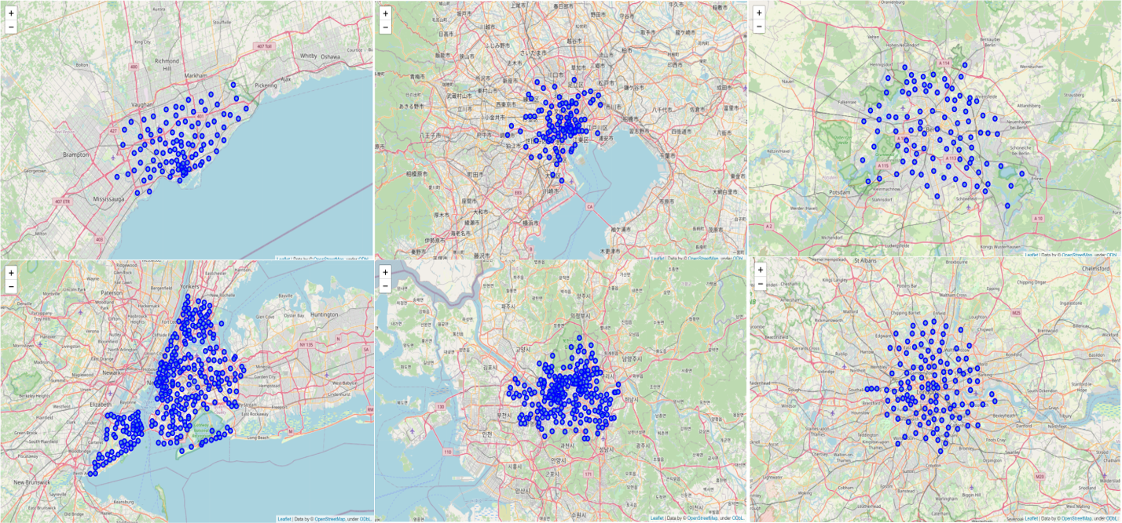
Neighborhoods

Slide 5
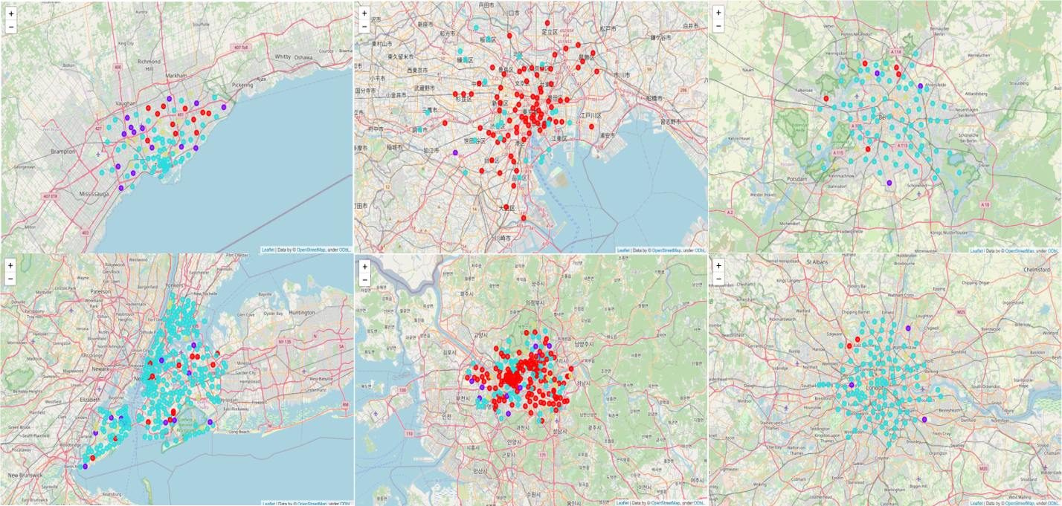
Clustering these neighborhoods based on most common venues leads to 4 distinct kinds of neighborhoods

Slide 6
These clusters show specific types of venues
Cluster Label | Most Common Venues | Count
Cluster 3 Parks and Trails | Park | 22
 | Trail | 4
Cluster 2 Bars and Food & Drink shops | Bar | 77
 | Food & Drink Shop | 77
Cluster 1 Athletics & Sports and Food & Drink shops | Athletics & Sports | 14
 | Food & Drink Shop | 4
Cluster 0 Asian Restaurants | Asian Restaurant | 223
 | Coffee Shop | 10

Slide 7
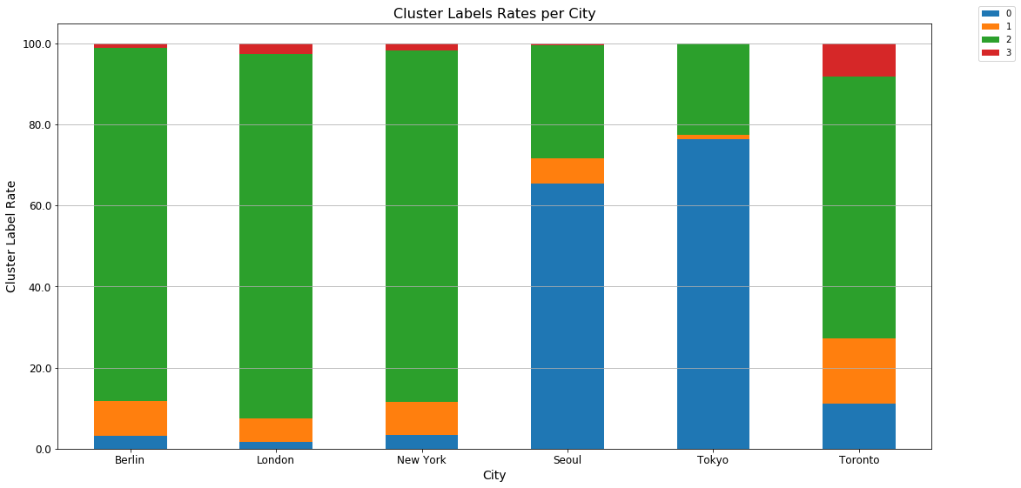
Proportions of cluster labels per city show clear trends. A lot of Asian restaurants in Seoul and Tokyo would be expected.

Slide 8
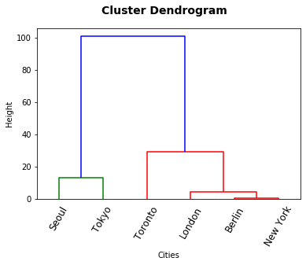
Hierarchical clustering of cities shows expected and unexpected results
Tokyo and Seoul are very similar in events
The most similar city to New York is Berlin ?!
Toronto stands out of the group of western cities

Slide 9
Conclusion
Cities can be clustered based on the most common events in their neighborhoods
Berlin would be the recommended travel spot for people who want a similar experience to New York
This analysis could be extended to more cities to create recommendation engines

